Slide 1
FEATURE EXTRACTION PRINCIPAL COMPONENT ANALYSIS
By : Shirish Pandagare
Aditya Lahiri

Slide 2
Agenda
The Curse of Dimensionality.
Feature Reduction by PCA
PCA on Python

Slide 3
The Curse of Dimensionality
A phenomena that occurs when the dimensionality of the data increases, the sparsity of the data increases.
Three Curse of dimensionality are
Complexity
Overfitting
Large number of data
Feature Extraction
Notes:
It becomes hard to look see the patterns in high dimensions.
Complexity :- With the increase in dimension, the running time of the algorithm increases too. Also, many algorithm with may work fine in low dimensions become intractable when the input is in high dimension.
Overfitting: - As the dimension is large, the number of samples may be too small for accurate estimation.
Thus, larges amount of data is required when we deal with high dimension.
To put it in simple scenario, if you have lost your key and you have to find it in a lobby or in a multi story building. It’s the same conundrum.
So one of the ways to over come with this curse, we can use Feature extraction methods like PCA.

Slide 4
What is feature extraction?
Feature extraction refers to the mapping of the original high-dimensional data onto a lower-dimensional space.
Original data
Reduced data
Linear transformation

Slide 5
What is Principal Component Analysis?
Principal component analysis (PCA)
Reduce the dimensionality of a data set by finding a new set of variables, smaller than the original set of variables.
Retains most of the input data information.
By information we mean the variation present in the sample, given by the correlations between the original variables.
The new variables, called principal components (PCs), are uncorrelated, and are ordered by the fraction of the total information each retains.
Notes:
The principal component analysis is basically transforming the data from the original dimension to the new set of dimension such that the correlation between the new dimensions are zero and are orthogonal to each other.
By transforming the data into new dimension, we retain the variation in the data.

Slide 6
Geometric picture of principal components (PCs)
Notes:
For example, Suppose I have this scattered data, the principal component would be something along the direction of the maximum variance, which look obvious here.

Slide 7
Geometric picture of principal components (PCs)
Notes:
Also, the distance from the Principal component to each point would be the minimum.

Slide 8
Geometric picture of principal components (PCs)
Notes:
The second principal component would be the orthogonal direction of the first principal component.

Slide 9
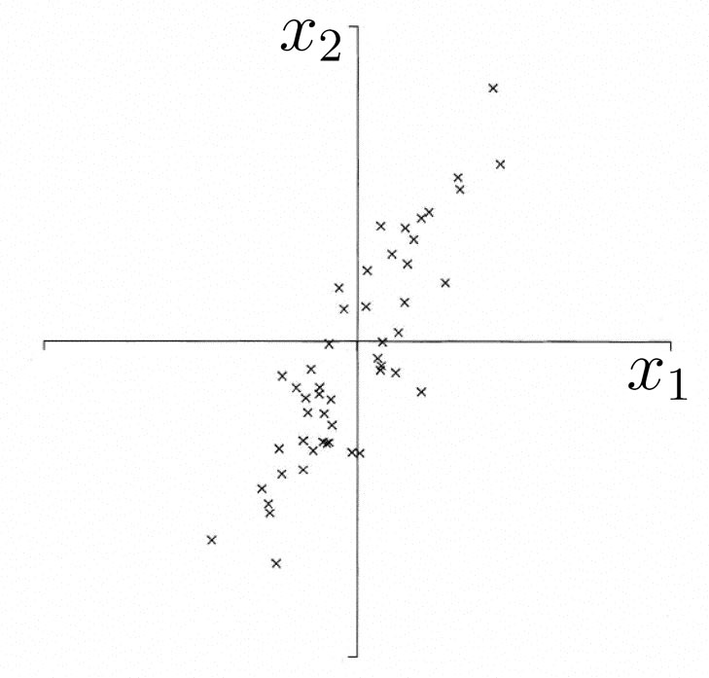
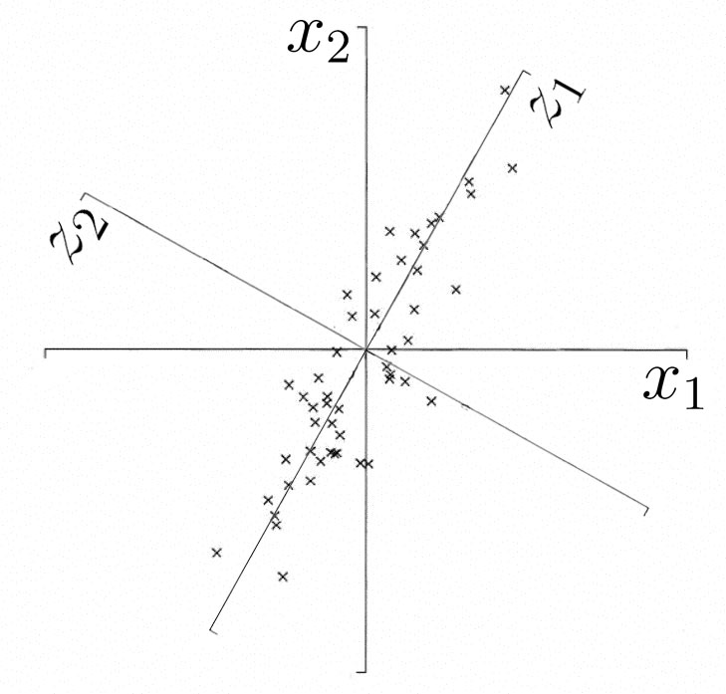
Geometric picture of Principal Components (PCs)
the 1st PC is a maximum variance fit to a line in X space
the 2nd PC is a second maximum variance fit to a line in the plane perpendicular to the 1st PC

Slide 10
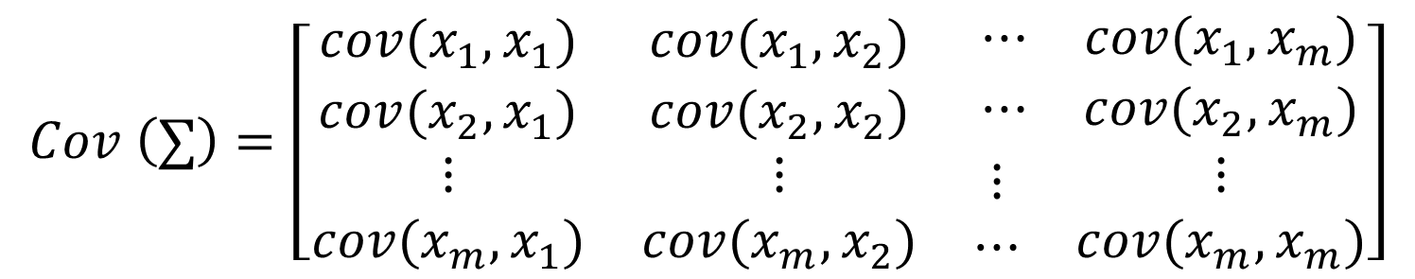
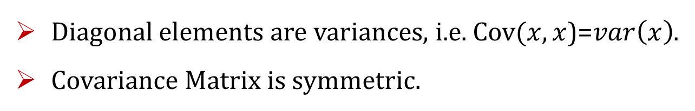
Covariance Matrix
$$Cov \left(∑\right)=\left[\begin{matrix}cov(x_{1},x_{1}) & cov(x_{1},x_{2}) & \begin{matrix}⋯ & cov(x_{1},x_{m})\end{matrix} \\ cov(x_{2},x_{1}) & cov(x_{2},x_{2}) & \begin{matrix}⋯ & cov(x_{2},x_{m})\end{matrix} \\ \begin{matrix}⋮ \\ cov(x_{m},x_{1})\end{matrix} & \begin{matrix}⋮ \\ cov(x_{m},x_{2})\end{matrix} & \begin{matrix}\begin{matrix}⋮ \\ ⋯\end{matrix} & \begin{matrix}⋮ \\ cov(x_{m},x_{m})\end{matrix}\end{matrix}\end{matrix}\right]$$
Diagonal elements are variances, i.e. $Cov(x,x$)=$var\left(x\right)$.
Covariance Matrix is symmetric.
Notes:
To compute the PC, we need to find the Covariance matrix for the data set.
covariance is a measure of the joint variability of two random variables

Slide 11
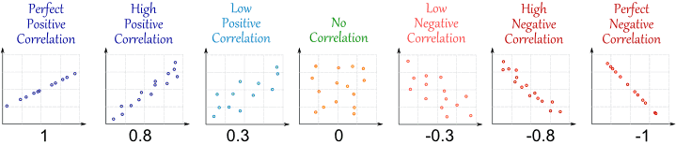
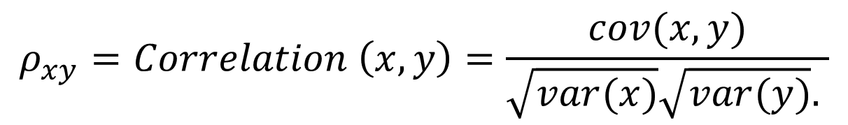

Correlation
$$ρ_{xy}=Correlation \left(x,y\right)=\frac{cov(x,y)}{\sqrt{var(x)}\sqrt{var(y)}. }$$
$$−1≤Correlation\left(x,y\right)≤+1$$
Notes:
If features in the dataset are in same scale, covariance matrix will work fine, however, if the scale is different, we need to standardize the covariance matrix which will yield a correlation matrix. If not done, our Principal components will be biased to the feature which has highest variance.
Once we get the Covariance and Correlation, we need to find the Eigen Vector and eigen values to look for the dimension which can cover maximum variation.

Slide 12
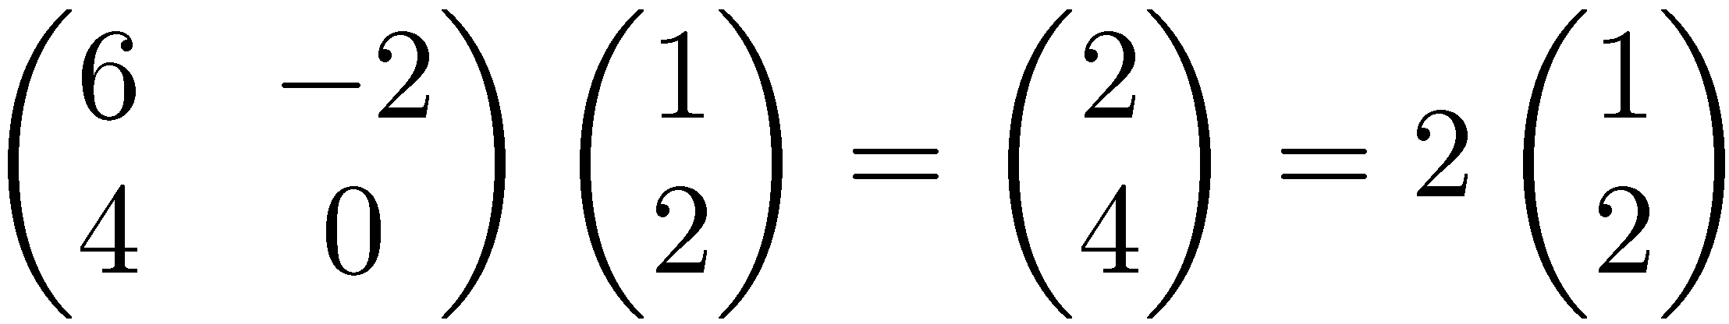






Eigenvalues & Eigenvectors
Eigenvectors (for a square m×m matrix S)
$$S\vec{v}=λ\vec{v}$$
Example
(right) eigenvector
eigenvalue
$$\vec{v}εℝ^{m}≠\vec{0}$$
$$λεℝ$$
$$S\vec{v}$$
$$\vec{v}$$
$$λ\vec{v}$$
Notes:
Do the eigen decomposition of the covariance or correlation of the data matrix. The eigen vectors associated with the largest eigen values represent the first principal component and the second largest represents the second and so on.
Let see this whole process on a simple data set.

Slide 13
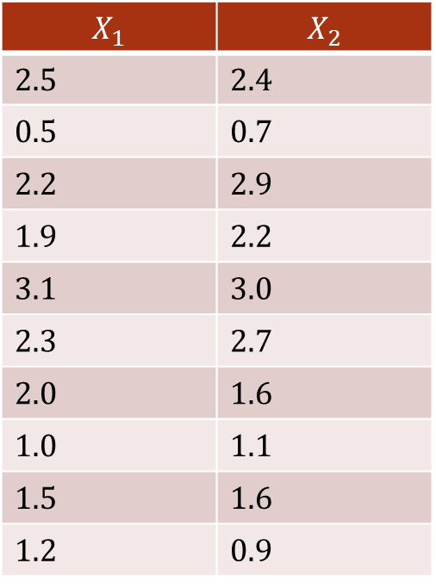
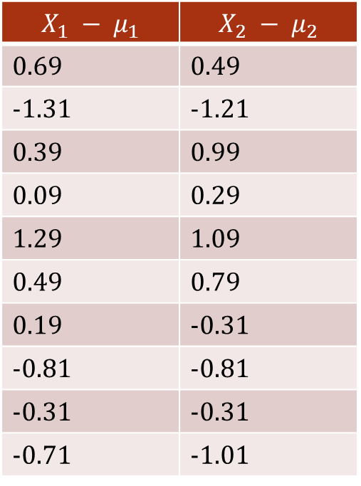
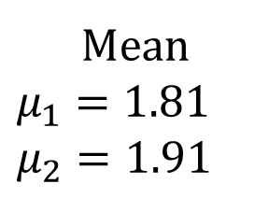
PCA Process – STEP 1
$$X_{1}$$ | $$X_{2}$$
2.5 | 2.4
0.5 | 0.7
2.2 | 2.9
1.9 | 2.2
3.1 | 3.0
2.3 | 2.7
2.0 | 1.6
1.0 | 1.1
1.5 | 1.6
1.2 | 0.9
$$X_{1} − μ_{1}$$ | $$X_{2} − μ_{2}$$
0.69 | 0.49
-1.31 | -1.21
0.39 | 0.99
0.09 | 0.29
1.29 | 1.09
0.49 | 0.79
0.19 | -0.31
-0.81 | -0.81
-0.31 | -0.31
-0.71 | -1.01
Mean
$$μ_{1}=1.81$$
$μ_{2}=1.91$
Notes:
2_Dimensional data set.
I will do the mean center of the data set for easy of my computation.

Slide 14

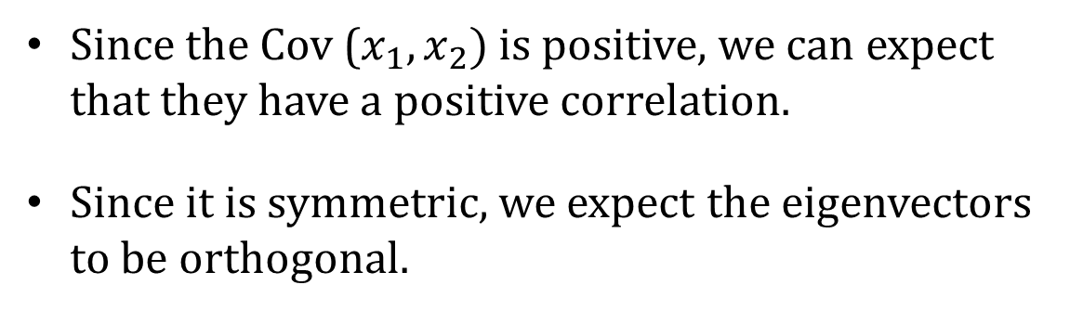
PCA Process – STEP 2
Calculate the Covariance matrix
$$cov=\left[\begin{matrix}0.6166 & 0.6154 \\ 0.6154 & 0.7166\end{matrix}\right]$$
Since the Cov ($x_{1}, x_{2})$is positive, we can expect that they have a positive correlation.
Since it is symmetric, we expect the eigenvectors to be orthogonal.

Slide 15
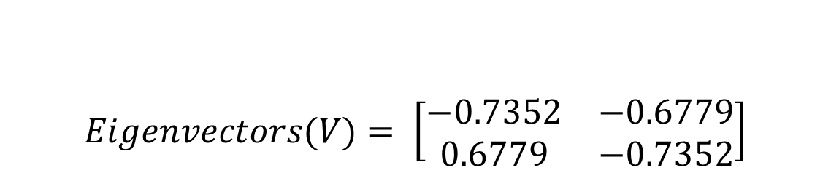
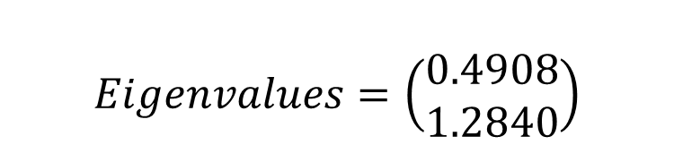
PCA Process – STEP 3
Calculate the Eigenvalues and Eigenvectors of the covariance Matrix
$$Eigenvalues=\left(\begin{matrix}0.4908 \\ 1.2840\end{matrix}\right)$$
$$Eigenvectors(V)= \left[\begin{matrix}−0.7352 & −0.6779 \\ 0.6779 & −0.7352\end{matrix}\right]$$
Notes:
In order to determine the how many principal components to select, we need to find the proportion of variation explained by first r eigen values. This can be computed by this

Slide 16
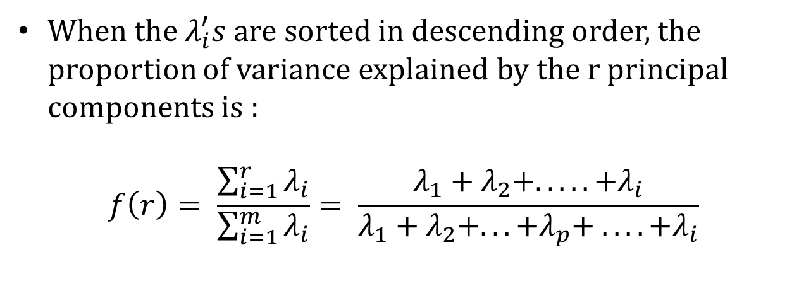
PCA Process – STEP 4
When the $λ_{i}^{′}s$ are sorted in descending order, the proportion of variance explained by the r principal components is :
$$f\left(r\right)= \frac{\sum_{i=1}^{r}{λ_{i}}}{\sum_{i=1}^{m}{λ_{i}}}= \frac{λ_{1}+λ_{2}+. . .. .+λ_{i}}{λ_{1}+λ_{2}+. . .+λ_{p}+ . . . .+λ_{i}}$$
If the dimensions are highly correlated, there will be small number of eigenvectors, thus r will be smaller.
If the dimensions are not correlated, r will be as large as m and PCA does not help.
Notes:
Proportion of variation.

Slide 17
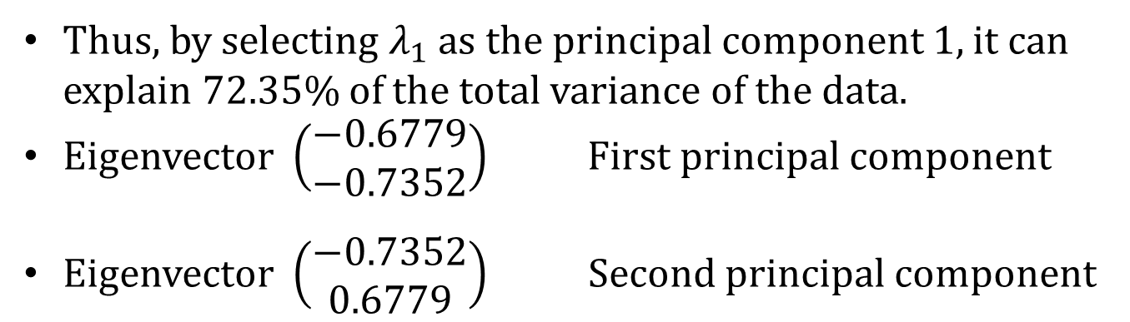
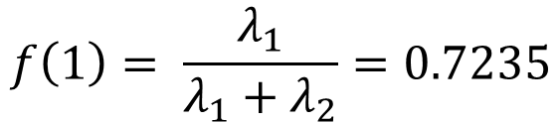
PCA Process – STEP 4
$$f\left(1\right)= \frac{λ_{1}}{λ_{1}+λ_{2}}=0.7235$$
Thus, by selecting $λ_{1}$ as the principal component 1, it can explain 72.35% of the total variance of the data.
Eigenvector $\left(\begin{matrix}−0.6779 \\ −0.7352\end{matrix}\right)$ First principal component
Eigenvector $\left(\begin{matrix}−0.7352 \\ 0.6779\end{matrix}\right)$ Second principal component

Slide 18




PCA Process – STEP 4
$$λ_{2}$$
$$Eigenvalues=\left(\begin{matrix}0.4908 \\ 1.2840\end{matrix}\right)$$
$$λ_{1}$$
$$Eigenvectors(V)= \left[\begin{matrix}−0.7352 & −0.6779 \\ 0.6779 & −0.7352\end{matrix}\right]$$
$$V_{2}$$
$$V_{1}$$

Slide 19
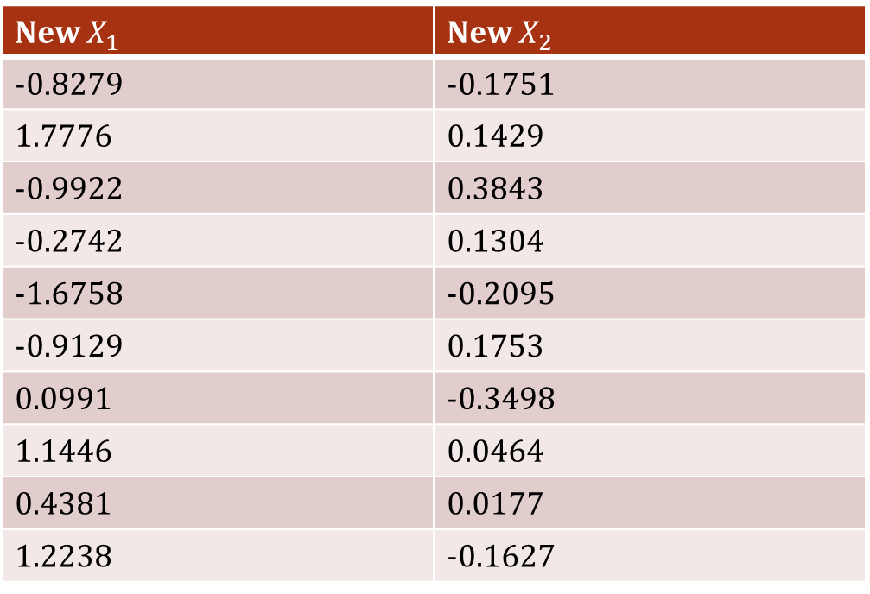

PCA Process – STEP 5
Derive the new data
$\left[\begin{matrix}\left(X_{1} − μ_{1}\right) & \left(X_{2} − μ_{2}\right)\end{matrix}\right].\left[\begin{matrix}V_{1} \\ V_{2}\end{matrix}\right]$
New $X_{1}$ | New $X_{2}$
-0.8279 | -0.1751
1.7776 | 0.1429
-0.9922 | 0.3843
-0.2742 | 0.1304
-1.6758 | -0.2095
-0.9129 | 0.1753
0.0991 | -0.3498
1.1446 | 0.0464
0.4381 | 0.0177
1.2238 | -0.1627

Slide 20
What We Have Done So Far….

Slide 21
What We Have Done So Far….

Slide 22
What We Have Done So Far….
p₂
p₁

Slide 23
What We Have Done So Far….
p₂
p₁
No correlation in the new representation of the data

Slide 24


What We Have Done So Far….
p₂
$$λ_{2}$$
p₁
$$λ_{1}$$

Slide 25
PCA on Python

Slide 26
THANK YOU

Slide 27
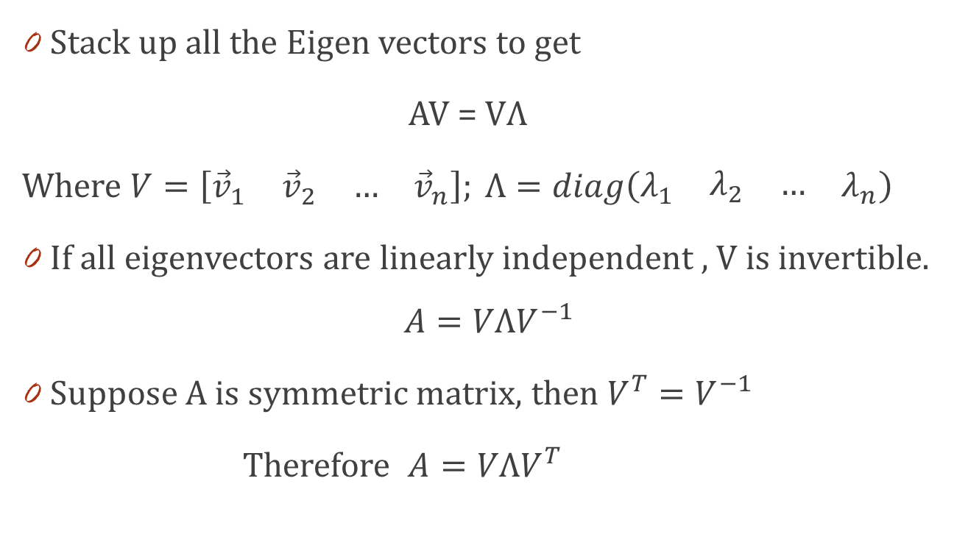
Diagonalization
Stack up all the Eigen vectors to get
AV = VΛ
Where $V=\left[\begin{matrix}{\vec{v}}_{1} & \begin{matrix}{\vec{v}}_{2} & …\end{matrix} & {\vec{v}}_{n}\end{matrix}\right]; Λ=diag\left(\begin{matrix}λ_{1} & \begin{matrix}λ_{2} & …\end{matrix} & λ_{n}\end{matrix}\right)$
If all eigenvectors are linearly independent , V is invertible.
$$A=VΛV^{−1}$$
Suppose A is symmetric matrix, then $V^{T}=V^{−1}$
Therefore $A=VΛV^{T}$

Slide 28
Algebraic definition of PCs
Given a sample of ‘n’ observations on a vector of ‘d’ variables
Define the first principal component of the sample by the linear transformation
Here a₁ is chosen such that v[z₁] is maximum.
where the vector

Slide 29
Algebraic definition of PCs
To find first note that
where
is the covariance matrix.

Slide 30
Algebraic definition of PCs
To find that maximizes subject to
Let λ be a Lagrange multiplier
therefore
is an eigenvector of S
corresponding to the largest eigenvalue

Slide 31
Algebraic definition of PCs
We find that is also an eigenvector of S
whose eigenvalue is the second largest.
In general
The k^{th} largest eigenvalue of S is the variance of the k^{th} PC.
The k^{th} PC retains the k^{th} greatest fraction of the variation
in the sample.

Slide 32
Algebraic derivation of PCs
Main steps for computing PCs
Form the covariance matrix S.
Compute its eigenvectors:
The first p eigenvectors corresponds to ‘p’ largest eigenvalues form the ‘p’ PCs.
The transformation G consists of the p PCs:

